Slide 1
Numerical Methods for Science and Engineering
Chapter one
Solutions to Linear System

Slide 2
Solution of Linear System by Elimination
Objective: Solve the system of linear equations to find roots of the system.
Gaussian Elimination: The process which eliminates an unknown from succeeding equations using elementary operations
Gaussian Elimination with Partial Pivoting
Select pivotal equation for a variable for elimination.
Eliminate the chosen variable from the remaining equations with respect to the pivotal equation.
Repeat the process for the subsystem.
Using back-substitution find solutions by using pivotal equations.
Output : By applying Gaussian Elimination with partial pivoting, system of linear equations can be solved to find roots (approximately) of the system.

Slide 3
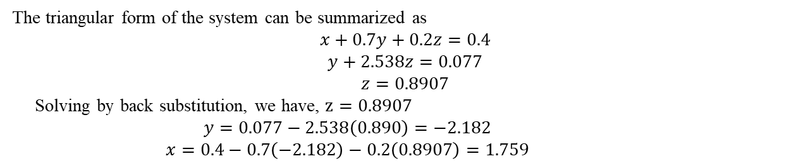
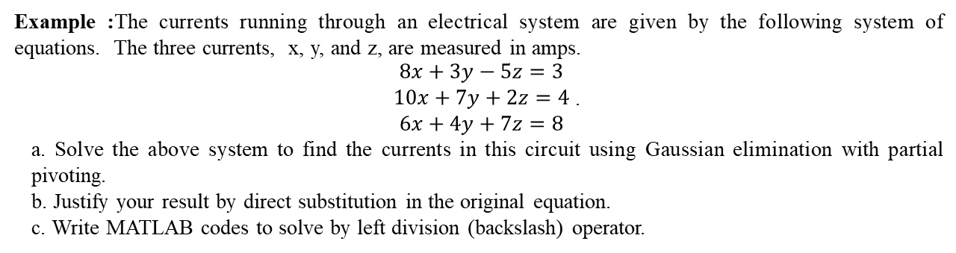
Example :The currents running through an electrical system are given by the following system of equations. The three currents, x, y, and z, are measured in amps.
$\begin{aligned}8x+3y−5z=3 \\ 10x+7y+2z=4 \\ 6x+4y+7z=8\end{aligned}$ .
a. Solve the above system to find the currents in this circuit using Gaussian elimination with partial pivoting.
b. Justify your result by direct substitution in the original equation.
c. Write MATLAB codes to solve by left division (backslash) operator.
Solution : a.
Oder | x | y | z | Constant | Eqn #
 | 8 | 3 | -5 | 3 | E1
 | 10 | 7 | 2 | 4 | E2
 | 6 | 4 | 7 | 8 | E3
E2/10 | 1.000 | 0.700 | 0.200 | 0.400 | E4 | 1st Piv eq^{n}
E1/8 | 1.000 | 0.375 | -0.625 | 0.375 | E5
E3/6 | 1.000 | 0.667 | 1.167 | 1.333 | E6
E5-E4 | 0 | -0.325 | -0.825 | -0.025 | E7
E6-E4 | 0 | -0.033 | 0.967 | 0.933 | E8
E7/(-0.325) | 0 | 1 | 2.538 | 0.0769 | E9 | 2nd Piv eq^{n}
E8/(-0.03) | 0 | 1 | -32.233 | -31.1 | E10
E9-E10 | 0 | 0 | 34.771 | 31.177
E10/(-32.233) | 0 | 0 | 1 | 0.897 |  | 3rd Piv eq^{n}
The triangular form of the system can be summarized as
$$x+0.7y+0.2z=0.4$$
$$y+2.538z=0.077$$
$$z=0.8907$$
Solving by back substitution, we have, $z=0.8907$
$$y=0.077−2.538\left(0.890\right)=−2.182$$
$$x=0.4−0.7\left(−2.182\right)−0.2\left(0.8907\right)=1.759$$

Slide 4
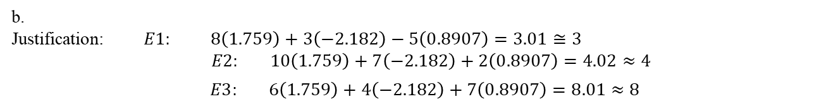
b.
Justification: $E1: 8\left(1.759\right)+3\left(−2.182\right)−5\left(0.8907\right)=3.01≅3$
$$E2: 10\left(1.759\right)+7\left(−2.182\right)+2\left(0.8907\right)=4.02≈4$$
$$E3: 6\left(1.759\right)+4\left(−2.182\right)+7\left(0.8907\right)=8.01≈8$$
c. >> A=[8 3 -5; 10 7 2; 6 4 7];
>> b=[3; 4; 8];
>> Solution = A\b
Solution = 1.7500, -2.1829, 0.8902

Slide 5
Sample MCQ
To solve the system of linear equation which method we use?
Gaussian elimination
Iterative method
Both
None
2. The process which eliminates an unknown from succeeding equations using elementary operations is known as
Gaussian Elimination
Gauss Jacobi Method
Gauss-Seidal Iterative Method
None
3. One such system is the upper triangular form which method is then used to solve the system?
Substitution
Back-substation
Both
None
4. The equation with maximum numerical coefficient of that variable in the system is called
Main equation
Pivotal equation
Iterative equation
None

Slide 6
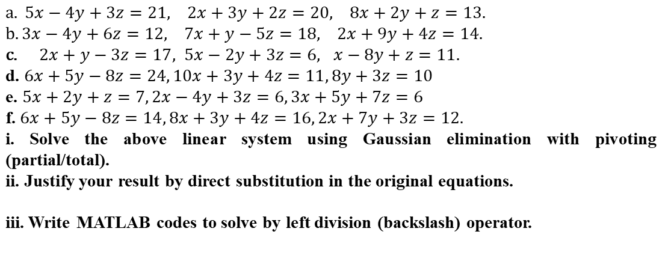
Exercise
1.
$a. 5x−4y+3z=21, 2x+3y+2z=20, 8x+2y+z=13.$ $b. 3x−4y+6z=12, 7x+y−5z=18, 2x+9y+4z=14.$ $2x+y−3z=17, 5x−2y+3z=6, x−8y+z=11.$ d. $6x+5y−8z=24, 10x+3y+4z=11, 8y+3z=10$ e. $5x+2y+z=7, 2x−4y+3z=6, 3x+5y+7z=6$ f. $6x+5y−8z=14, 8x+3y+4z=16, 2x+7y+3z=12.$
i. Solve the above linear system using Gaussian elimination with pivoting (partial/total).
ii. Justify your result by direct substitution in the original equations.
iii. Write MATLAB codes to solve by left division (backslash) operator.

Slide 7
2. Cory, Josh and Dan went shopping for Halloween treats. Cory bought 3 chocolate pumpkins, 4 masks and 8 candy witches. He spent $36.65. Josh bought 5 chocolate pumpkins,3 masks and 10 candy witches. He spent $37.50. Dan bought 4 chocolate pumpkins, 5 masks and 6 candy witches. He spent $43.45.
i. Write a system of equations to represent this problem
ii. Solve the system of linear equation using Gaussian elimination with partial pivoting.
iii. Write MATLAB codes to solve by left division (backslash) operator.
3. A local computer company sells three types of laptop computers to three nearby stores. The number of laptops ordered by each store and the amount owing to the company for the order is shown in the following table:
Store | Laptop A | Laptop B | Laptop C | Amount Owing($)
Wal-Mart | 10 | 8 | 6 | 21 200
Sears | 7 | 9 | 5 | 18 700
Target | 8 | 4 | 3 | 13 000
i. Write a system of equations to represent the above information.
ii. Solve the system of linear equation using Gaussian elimination with partial pivoting.
iii. Write MATLAB codes to solve by left division (backslash) operator.

